Slide 1

What is nonclassical about quantum interference?
QPL 2023, Paris - 18/7/2023
Lorenzo Catani
Joint work with Matt Leifer, Giovanni Scala, David Schmid and Rob Spekkens
arXiv: 2211.09850 (2022)
arXiv:2207.11779 (PRL 129 240401(2022))
arXiv: 2111.13727 (2021)
Notes:
This as we will see is related also to the question of what is nonclassical about uncertainty relations.
But the first point really is to specify what is meant here by nonclassical, and why then this is a meaningful question. After all it has always been taught to us that uncertainty relations are a main feature of quantum theory that state a departure from the classical worldview.
(Well, are we sure that this is really the case? To answer the question we need to first define a valid notion of nonclassicality. In quantum foundations one of the main area of research is to understand what constitute a valid notion of classicality and nonclassicality. There are criteria, and generalized noncontextuality, that we adopt here, satisfies all of them. )

Slide 2
What is meant by nonclassical?
Notes:
In quantum theory.
Don’t know if you have a preferred notion of nonclassicality? SYNCHRONIZE WITH THE AUDIENCE.

Slide 3
What do you mean by nonclassical?
Menti.com
Code:6935 0614
Notes:
What is nonclassical about quantum theory?
In quantum theory.
Don’t know if you have a preferred notion of nonclassicality? SYNCHRONIZE WITH THE AUDIENCE.
If you don’t know what to answer imagine for example what sounded and still sounds very puzzling about quantum theory when you first study it. I’m sure that given that you’re doing this job you had a moment when you got interested and felt that you have to take up the challenge to solve some unresolved issue in quantum theory.

Slide 4
Some common answers
Teleportation
Remote steering
No-cloning
Entanglement
Wave-particle duality
Nonlocality
Quantum interference
Coherent superposition
Uncertainty relations
Notes:
I prepared this in case you were not giving the answers I wanted in order to follow my narrative. But you did a great job / or, you are too well educated.
Here let me mention some common answers that you often hear.
Or also things that are now part of the folklore and that even non-expert have heard about concerning the weirdness of quantum theory.
Last week I was coming back from a festival and of course what do you talk of in the car if you have a physicist in: the weird aspects of quantum theory.
Of course people start with entanglement… and you don’t want to let them down so for sure you confirm that entanglement is a very nonclassical feature, you can have this very correlated states and do crazy things with it. Then you hear superposition quantum interference.
(For example what was taught to me in school. I don’t know if you hade the same experiences.)
Quantum interference in the implementation of two-slit experiment even famously claimed to capture the only mystery of quantum theory.
Then blabla, Just to name a few also because I finished the colors to use. In few minutes the people in the car are asleep.
But the point I wanted to make here is that this picture looks quite confusing. Can we single out the feature that establishes the mystery, or I would say the conceptual innovation of quantum theory with respect to the classical world view? Or, at least, can we formulate criteria for a good notion of classicality, and so of nonclassicality?
(Do a pool for QPL)

Slide 5
What constitutes a good notion of classicality?
Notes:
We’re at a foundations conference. So I think it’s good to spend some time on which criteria constitute a good notion of classicality.
Having in mind that we want to understand the conceptual innovation of quantum theory with respect to the classical worldview with it. So distill the mysterious aspect, the essence of quantum theory with it.

Slide 6
Criteria for a good notion of classicality
Mathematical notion establishing a boundary between what is interpretationally problematic and what is not.
Applicable to a broad range of physical scenarios.
Subject to direct experimental test.
Constitutes a resource.
Notes:
Mathematically rigorous definition that you can prove theorems and no-go theorems with. Mathematical notion that endorses a principle establishing a boundary between what is interpretationally problematic and what is not.
(SAY previous slide Because remember our goal is to show what is the conceptual innovation of quantum theory with respect to the classical worldview.)
Endorsing a principle also obeyed by classical physics otherwise it wouldn’t be a notion of classicality, but it’s not just relegated to that. We want to distill the mystery/ the conceptual innovation of quantum theory with respect to the classical worldview and so be more permissive with what is the notion of classicality.
A principle we think our scientific theory should obey, otherwise it’d constitute an interpretational problem. Somehow its violation has to capture what constitutes a mystery.

Slide 7
Preparation noncontextuality
R.W. Spekkens, Phys. Rev. A 71, 052108 (2005)
Two preparations are operationally equivalent, , if
In a preparation noncontextual ontological model,
Notes:
Imagine a prepare and measure scenario.
Define any letter appearing in the slide.
Operational equivalence. For example in quantum theory two possible convex mixtures that give the completely mixed state of a qubit represent two operationally equivalent preparations. Two contexts.
Noncontextuality is the requirement that operational equivalences imply ontological equivalences.
I assume here a basic knowledge of what is an operational theory and an ontological model (or hidden variable model).
Quantum theory does not admit of a preparation noncontextual ontological model.
Still it is interesting that there exist theories that admit of a noncontextual model but that manifest some of the properties I mentioned in the previous slide.
Preparation noncontextuality implies outcome determinism for sharp measurements.
The idea motivating this notion is that the best explanation for two preparations procedures that cannot be operationally distinguished in principle, by any measurement or transformation, is that they are the same object.
Same for Measurements and Transformations. If they give me the same statistics I say they are equivalent. No go theorem also for transformations. Not for measurements.
Universally i.e. prep NC, meas NC, transf NC.

Slide 8
Criteria for a good notion of classicality
Mathematical notion establishing a boundary between what is interpretationally problematic and what is not.
Applicable to a broad range of physical scenarios.
Subject to direct experimental test.
Constitutes a resource.

Slide 9
Criteria for a good notion of classicality
Instance of Leibnizian methodological principle / no fine-tuning.
Applicable to a broad range of physical scenarios.
Subject to direct experimental test.
Constitutes a resource.
Notes:
Say again the def on Leibnizianity and why it establishes a principle between what is intepretationally problematic and not. i.e. because basically it’s a no-conspiracy principle for what constitutes a good realist explanation of a physical theory.

Slide 10
Criteria for a good notion of classicality
Instance of Leibnizian methodological principle / no fine-tuning.
Applicable also to single qubit; subsumes other notions.
Subject to direct experimental test.
Constitutes a resource.
Notes:
Applies to a broad class of physical scenarios. For ex a single system unlike locality. And single qubit unlike KS. Also it does not assume QT, and it is reobtained in the limit of sufficient noise or coarse graining or decoherence.
Subsumes all. Proof of nonlocality can be turned into a proof of contextuality. KS noncontextuality is measurement noncontextuality + outcome determinism for sharp measurements. Also connected to positivity of quasirep which is very important in quantum optics.
Simplex embeddability is the notion of classical explainability in GPTs.

Slide 11
Criteria for a good notion of classicality
Instance of Leibnizian methodological principle / no fine-tuning.
Applicable also to single qubit; subsumes other notions.
It is empirically testable.
Constitutes a resource.

Slide 12
Criteria for a good notion of classicality
Instance of Leibnizian methodological principle / no fine-tuning.
Applicable also to single qubit; subsumes other notions.
It is empirically testable.
Its violation is connected to quantum computational advantages.
For more, see David Schmid’s lectures at Solstice of Foundations.
Notes:
Quantum computation, cryptography, metrology, communication, state-discrimination, cloning, …

Slide 13
What is nonclassical about quantum interference?
QPL 2023, Paris - 18/7/2023
Lorenzo Catani
Joint work with Matt Leifer, Giovanni Scala, David Schmid and Rob Spekkens
arXiv: 2211.09850 (2022)
arXiv:2207.11779 (PRL 129 240401(2022))
arXiv: 2111.13727 (2021)
Notes:
So if we come back to the title now that we have our preferred notion of classicality in hand, what it really means is:

Slide 14
What is contextual about quantum interference?
QPL 2023, Paris - 18/7/2023
Lorenzo Catani
Joint work with Matt Leifer, Giovanni Scala, David Schmid and Rob Spekkens
arXiv: 2211.09850 (2022)
arXiv:2207.11779 (PRL 129 240401(2022))
arXiv: 2111.13727 (2021)

Slide 15
Is quantum interference a nonclassical phenomenon?
Notes:
But let us first understand if this is an interesting question to ask. After all, as we said quantum interference is claimed to capture the essence of quantum theory. So the first question is to ask whether quantum interference is nonclassical, meaning that it is not possible to account for it in a noncontextual theory.

Slide 16
“In this chapter we shall tackle immediately the basic element of the mysterious behavior in its most strange form. We choose to examine a phenomenon which is impossible, absolutely impossible, to explain in any classical way, and which has in it the heart of quantum mechanics. In reality, it contains the only mystery. We cannot make the mystery go away by explaining how it works. We will just tell you how it works. In telling you how it works we will have told you about the basic peculiarities of all quantum mechanics.”
R. Feynman (1918-1988)
Feynman’s lecture of physics, 3rd book (1961).
Notes:
For sure, who thought that quantum interference is an inherently nonclassical phenomenon was Feynman. In introducing the two slit experiment in quantum theory he says that..
And honestly, I don’t know about you, but I remember personally that when I first was thought about the two slit experiment I was shocked.

Slide 17
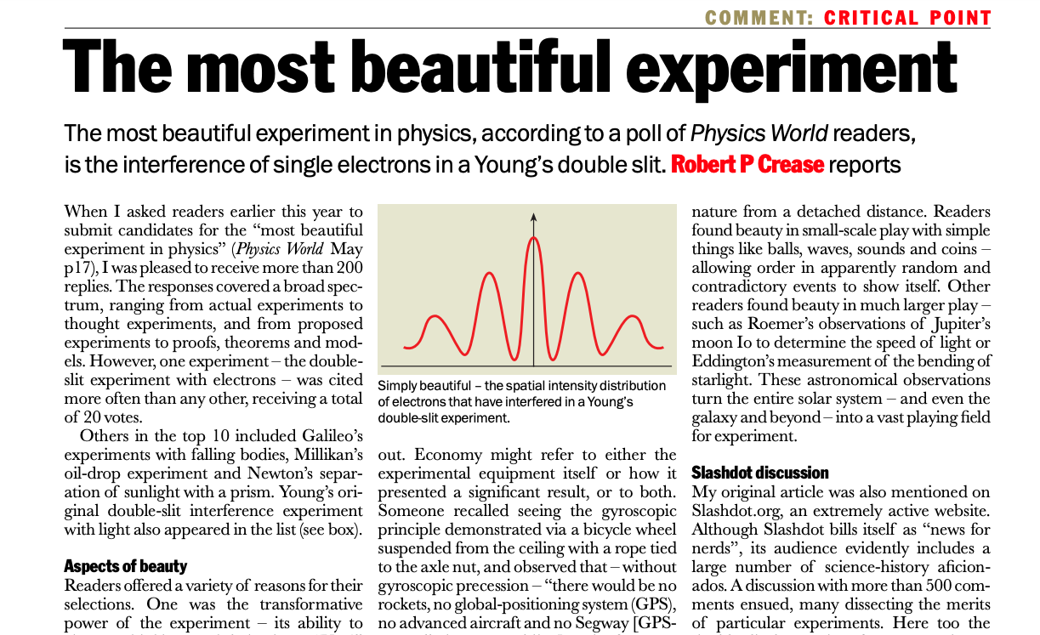
Robert P Crease 2002 Phys. World 15 (9) 19
Notes:
In 2002 the readers of Physics World voted the two-slit experiment on an electron as the most beautiful experiment in the world. And it was firstly done in Bologna in the seventies (1974) despite Feynman himself was skeptical that an experiment where single electron can be sent and tracked was possible.
A professor told us the whole story.

Slide 18
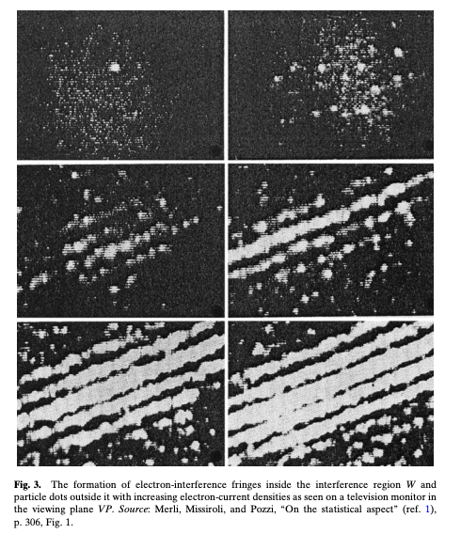
Quantum interference in Bologna
Credit: Photograph by Pino Guidolotti
G. Pozzi, G. F. Missiroli, P. G. Merli, Sole 24 ore 6/9/2003
Rodolfo Rosa Physics in Perspective volume 14, pages178–195 (2012)
Notes:
Probably you also had these moments, I remember I was extremely excited hearing the story. I felt that it was the most quantum thing about quantum theory and where the mystery lies. And somehow motivated to unveil the mysteries.
After few years of study and research on QT let’s go back to quantum interference and study its nonclassicality.
It was revolutionary because, for the first time, they could see in the TV monitor the electrons arriving one by one on the screen. One electron on the apparatus at any one time. i.e. interference fringes by single electrons.
There can be no doubt, however, that Merli, Missiroli, and Pozzi carried out the
first conclusive double-slit single-electron interference experiment
They obtained an interference pattern with an electron
microscope that was fitted with a special interferometer, an electron biprism, that
consisted basically of a very thin wire oriented perpendicularly to the electron
beam and positioned symmetrically between two plates at ground potential, so
that when a positive or negative potential was applied to the wire the electron
beam was split into two deflected components.
Their use of this electron biprism
was the first important technical and conceptual feature of their experiment; the
second was its ability to observe the continuous arrival of the electrons, one at a
time, on a television monitor.
Merli-Missiroli-Pozzi.
Implemented in Bologna. I was really excited. A professor told us the whole story.

Slide 19
Quantum interference in the Mach-Zehnder interferometer
Wave-like behavior
Particle-like behavior
Notes:
Let us consider the simplest case where to see quantum interference phenomenology. This is like the famous two slit experiment, but with only two possible paths. In particular the story is the following…
In this paper we use the name TRAP, not basic. Meaning…. .
Because
(The first can be achieved by the preparation procedure where the beamsplitter has reflectivity 1/2 (a 50-50 beamsplitter) and the relative phase-shift between the two paths is 0 or pi, because in this case the which-phase measurement is perfectly predictable while the which-way measurement is completely unpredictable. The second point can be achieved by the preparation procedure where the beamsplitter has reflectivity 0 (i.e., no beamsplitter) or reflectivity 1 (a perfect mirror), because in this case it is the which-way measurement that is perfectly predictable and the which-phase measurement that is completely unpredictable.
The wave-particle duality relation describes the tradeoff in predictabilities between these two extreme cases.

Slide 20
The TRAP phenomenology of quantum interference
The above scenarios are enough to reproduce the phenomenology that is Traditionally Regarded As Problematic (TRAP phenomenology).
Interpretational claims usually associated with the TRAP phenomenology:
Wave-particle complementarity
The observer dependence of reality
The failure of explanation in terms of local causes
Notes:
i.e. the phenomenology that is usually pointed at as supporting the three interpretational claims that we highlighted in the introduction.

Slide 21
The TRAP phenomenology in the toy field theory
L. Catani, M. S. Leifer, D. Schmid, R. W. Spekkens, arXiv: 2111.13727 (2021).
Notes:
This figure is not made to be understood, just to show that there is a such a theory. It is taken from this paper, that I presented last year at QPL, so if this made you curious you can go and have a look at it.
Need to say what is the toy field theory and how it reproduces the TRAP phenomenology.
Wave-like behaviour on top and particle-like on the bottom.
The toy field theory is a classical statistical theory over discrete fields (two field modes associated witht he left and right paths) with an epistemic restriction, i.e. a restriction on what probability distributions are allowed. It is noncontextual.
Each mode has two properties well specified at all times: occupation number and phase.
(I’ll say this later: Crucially for reproducing this is to use an ontology of fields and the fact that the analogue of the quantum state, in particular the vacuum state, is a state of knowledge. In particular the vacuum state is a valid state of knowledge as any other, and so it can carry information, in particualar the information of the local phase.)
(The first can be achieved by the preparation procedure where the beamsplitter has reflectivity 1/2 (a 50-50 beamsplitter) and the relative phase-shift between the two paths is 0 or pi, because in this case the which-phase measurement is perfectly predictable while the which-way measurement is completely unpredictable. The second point can be achieved by the preparation procedure where the beamsplitter has reflectivity 0 (i.e., no beamsplitter) or reflectivity 1 (a perfect mirror), because in this case it is the which-way measurement that is perfectly predictable and the which-phase measurement that is completely unpredictable.
The wave-particle duality relation describes the tradeoff in predictabilities between these two extreme cases.

Slide 22
Undermining the standard interpretational claims
Wave-particle complementarity
The nature of systems do not change.
Notes:
In the toy field theory the nature of systems do not change.
There are always two modes with particle-like (occupation number) and wave-like (phase) properties at all times.
Variability concerns what is known about them, not them.

Slide 23
Undermining the standard interpretational claims
The observer dependence of reality
What the observer knows about the properties depends on the measurement.
Notes:
What the observer knows about the particle-like and wave-like properties depends on the measurement. Again, each mode has both a particle-like property and a wave-like property at all times.

Slide 24
Undermining the standard interpretational claims
The failure of explanation in terms of local causes
All operations are local.
Notes:
All operations are local. In particular, the detector on arm R locally flips the phase of mode R with probability ½ and leaves it the same with probability ½ .
This phase information propagates forward to the second beam splitter, determines the relative phase, and so which output port fires.

Slide 25
Undermining the standard interpretational claims
Wave-particle complementarity
The observer dependence of reality
The failure of explanation in terms of local causes
The nature of systems do not change.
What the observer knows about the properties depends on the measurement.
All operations are local.
Notes:
What was thought to be a causal influence is mere inference, an update of knowledge.
Say how crucial is that the unoccupied mode carries information. Analogue of vacumm state is a valid epistemic state that carries information (the unoccupied state with two possible values of phase; so a bit of info). Which is a consequence of the epistemic restriction.

Slide 26
The toy field theory reproduces the TRAP phenomenology of quantum interference, while rejecting the interpretational claims that are usually associated with it.
Notes:
I’m not going into the details of the result, I gave a talk on it last year at QPL. But the summary is that the TRAP phenomenology of quantum interference does not capture the essence of quantum theory. The toy field theory provides a straightforward and unambiguous account of the TRAP phenomenology in terms of the statistical mechanics of a classical (discrete) field theory.

Slide 27
The phenomenology of Elitzur-Vaidman bomb tester, Wheeler delayed choice experiments, and the quantum eraser can also be reproduced in the toy field theory.
Notes:
As an aside…
But what is important for us now is that the question of the title makes sense. Because we showed that noncontextual theories can manifest the basic phenomenology of quantum interference.

Slide 28
Motivation
There exist noncontextual theories that manifest the basic phenomenology of quantum interference.
Are there aspects of quantum interference that witness contextuality?
Notes:
So I’ve seen that the experiment that really excited me does not really capture the essence of quantum theory in its basic implementation, or at least for the interpretational claims that it is usually said to support. But maybe we need to study more its nuances.
We now see why it is meaningful and well motivated the question in the title.
Which aspects of quantum interference beyond this TRAP phenomenology, if any, witness nonclassicality, here in the form of contextuality?
Before answering this, I wanted to show a table that lists many phenomena (also mentioned from you at the beginning) that also can be reproduced in noncontextual theories of the kind I just showed. And in particular I’m going to focus on one in order to then also answer the question about what is nonclassical about quantum interference.

Slide 29
Phenomena arising in noncontextual theories
R. W. Spekkens, in Quantum Theory: Informational Foundations and Foils, pp 83-135, Springer Dordrecht (2016).
L. Catani, M. Leifer, D. Schmid and R.W. Spekkens, arXiv:2111.13727 (2021).
Notes:
And notice that this question is not only meaningful in the case of quantum interference. Here I wanted to show this table, which is an updated version of the one contained in this paper by Spekkens. You say that basically everything but contextuality and nonlocality can be obtained in a toy theory like the one before.
Taken from this paper where I’ve also added some new ones coming from our paper.

Slide 30
Phenomena arising in noncontextual theories
R. W. Spekkens, in Quantum Theory: Informational Foundations and Foils, pp 83-135, Springer Dordrecht (2016).
L. Catani, M. Leifer, D. Schmid and R.W. Spekkens, arXiv:2111.13727 (2021).
Notes:
And, in particular, before going to the specific case of quantum interference I wanted to focus on UR. That we will see play a crucial role to also answer the question of what is nonclassical about quantum interference.
So we have explained that the mere existence of these phenomena are not enough to claim nonclassicality, where our preferred notion of nonclassicality is generalized contextuality. Now we ask whether there are more nuanced aspects of these phenomena that can witness contextuality. In particular, we start from uncertainty relations to then go back to quantum interference.

Slide 31
Are there aspects of uncertainty relations that witness contextuality?

Slide 32
Contents
Uncertainty relations
What aspects of uncertainty relations witness contextuality
What aspects of quantum interference witness contextuality
Notes:
So what we’re gonna do now… If the chairman agrees… Questions?

Slide 33
Contents
Uncertainty relations
What aspects of uncertainty relations witness contextuality
What aspects of quantum interference witness contextuality

Slide 34
Product uncertainty relations in quantum theory
H.P. Robertson (1903-1961)
W. Heisenberg (1901-1976)
Notes:
1) Heisenberg-Robertson UR bounds the variances (measures of uncertainty) of two observables with the expectation value of their commutator (also Schrodinger improved this, but still has the same problem below).
About joint predictability of two measurements on a state. So like us, not like error-disturbance UR, about trade-off between info gain and disturbance.
2) However these are unsatisfactory in the finite dimensional case.
Both expectation value of variances are calculated on a state psi. They are state dependent (the RHS). So imagine that A and B are Pauli X and Z for a qubit, and you choose as psi one of their eigenstate, e.g. of X, then this uncertainty relation is trivial. Even if the measurements are incompatible and have a tradeoff relation on their predictabilities for that state.
(Pair of measurements for which there is a nontrivial tradeoff in their predictabilities.
UR express limits on the extent to which the outcomes of distinct measurements on a single state can be made jointly predictable.)

Slide 35
Sum uncertainty relations in quantum theory
In the case of Pauli and measurements on a qubit,
.
Given that and
‘
Notes:
A solution to the above is to consider sums instead of products. For this talk we consider Pauli X and Z measurements, that are complementary and are the discrete analogue of position and momentum. In general, our results will hold for any two binary-outcome measurements. Non-complementary too (as long as A12-symmetry is assumed).
This tradeoff relation holds for any state in quantum theory, and so it is an uncertainty relation. Its validity comes from the fact that it is a description of the Bloch ball of qubit quantum states. RHS is state independent now.
Other versions of these are the entropic UR. Connected to ours, but we do not deal with them. I can spend some words later on them.
Expecation values, (the modulus of which is what we call predictability) connected linearly with the probabilities of obtaining outcome of X and Z and you can really see them as the projections onto the X and Z axis in the Bloch sphere.
If you have a function of the probability distributions of outcomes of two observables that is bounded, then it is an uncertainty relations.
Variances (above )and entropies represent uncertainties, while expectation values represent directly the predictabilities (below).

Slide 36
Examples of uncertainty relations for different theories
Notes:
Here we will consider theories with a 4-dimensional real valued vector representation. We refer to measurements X,Z as associated with directions in the real-valued representation that are mutually orthogonal to one another (and to the unit effect). We denote them with X and Z. Our results will also apply to non-orthogonal measurements.
Imagine prepare and measure scenario. We can imagine that each preparation and measurement effect as a real-valued vectors, and the probability is given by their inner product.

Slide 37
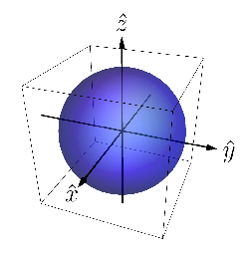
Qubit theory
Notes:
Here I’m going to just show the state spaces, not the effect spaces.
In particular we consider simple examples. We start with the state-space representation of the qubit, which is the standard Bloch ball (effect space is the same – strong self-duality). In R3 we represent a 4-dimensional space of Hermitian operators. Every qubit operator is represented as a linear combination of elements of a basis of the 4-dimensional space of Hermitian operators.
The expectation values of X and Z are linearly related to the probability of getting X and Z, and so with the projections of the state space on those axes.
(Need to tell what are X and Z in general. And that we’re in the prepare and measure scenario.
An operational theory in a prepare and measure stipulates the preparations the measurements and an algorithm for computing the predicted probabilities of an outcome given preparation and measurement for all possible preparations and measurements.
We can imagine that each preparation and measurement effect as a real-valued vectors, and the probability is given by their inner product.)

Slide 38
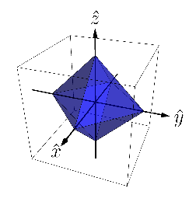
Stabilizer theory
Notes:
Stabilizer states = eigenstates of Pauli observables and their closure. Same for the effects.
Again, you can read off the uncertainty relation from the shape of the phase space, of its projection onto the xz plane. And you see here it’s linear.
The expectation values of X and Z are linearly related to the probability of getting X and Z, and so with the projections of the state space on those axes.

Slide 39
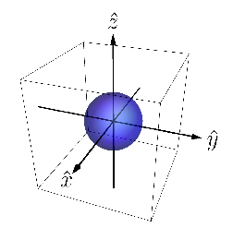
depolarized qubit theory
Notes:
Full set of qubit effects, but restricted state space under the eta depolarizing map, which is just the channel that maps any state in the Bloch sphere to a mixture of the same state and the completely mixed state, with probabilities (1-eta) and eta.
Contracted Bloch sphere but with a radius 1-eta.
The expectation values of X and Z are linearly related to the probability of getting X and Z, and so with the projections of the state space on those axes.

Slide 40
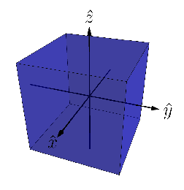
Gbit theory
Notes:
Gbit theory, but defined for 3 binary outcome measurements, where one can get full predictability jointly for X, Y, Z. Effect space is the same as qubit stabilizer theory.
X, Z perfectly predictable jointly.
The expectation values of X and Z are linearly related to the probability of getting X and Z, and so with the projections of the state space on those axes.

Slide 41
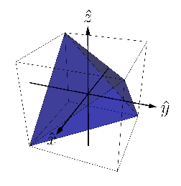
Simplicial theory
Notes:
Classical theory of a pair of classical random variable, which we denote with X and Z. State space is convex hull of 4 possible joint assignments of values to X and Z (tetrahedron), while the effect space is the dual to this simplex (the hypercube).
Again, like for the Gbit theory, X, Z perfectly predictable jointly.

Slide 42
Comparison of uncertainty relations
Legend
Notes:
Predictability of X and of Z plotted.
Quantum UR is represented by the section of a circle.

Slide 43
Contents
Uncertainty relations
What aspects of uncertainty relations witness contextuality
What aspects of quantum interference witness contextuality

Slide 44
How to link uncertainty relations and contextuality?
Problem:
Uncertainty relations single state.
Contextuality requires operational equivalences (at least 4 states).
Notes:
An UR expresses the predictability tradeoff between two measurements for any single state in the theory.
Contextuality requires at least 4 states (and two tomographically complete measurements like X and Z here).
What would you do? SYNCHRONIZE WITH THE AUDIENCE.
If you think, what we should do, we should consider states that satisfy some symmetry condition such that there exist other states with same predictabilities that give operational equivalences. More precisely,…

Slide 45
How to link uncertainty relations and contextuality?
Solution:
Consider uncertainty relations for theories satisfying .
Notes:
Consider operational theories with a pair of joint measurements, denoted X,Z, and a state that satisfies the condition of A12 orbit realizability.

Slide 46
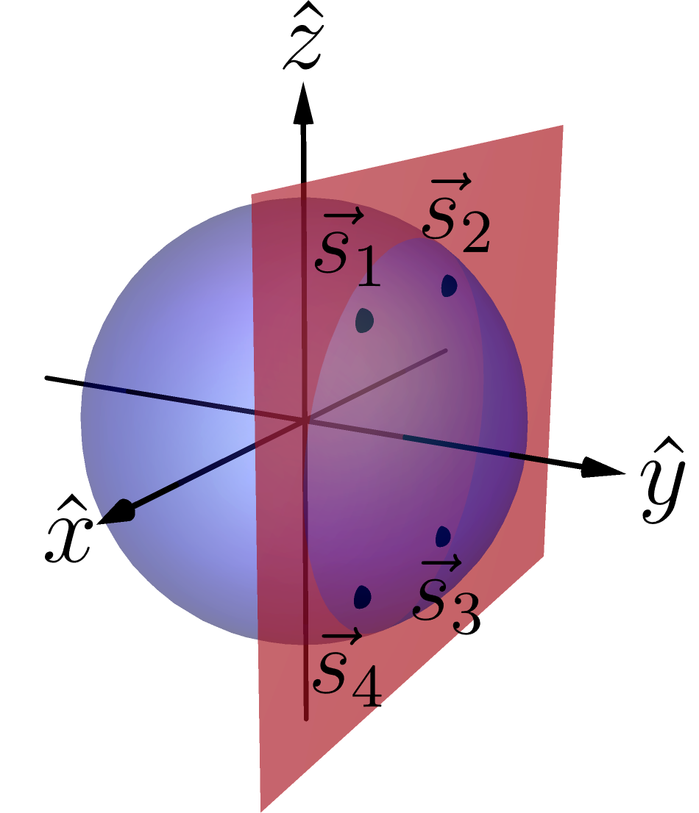
The condition
For every state in the theory:
The state has equal predictability counterparts.
The state manifests operational equivalences with such counterparts.
Example in the qubit theory:
Notes:
i.e. there exists other states (at least other 3) that have the same predictabilities, in modulus, for X and Z. Other states manifest those predictabilities, so they also show the same uncertainty relation!
i.e. among these states there are at least 3 with which the state can have operational equivalence. Moreover, among these states there are operational equivalences.
A state that satisfies these we say that it satisfies A12 orbit realizability.
So they lie in a rectangle in a plane parallel to the ZX plane. These vertices are the orbit of the original state under the action of the symmetry group of a rectangle under reflections, the Coxeter group A21. That’s why the name. Basically it’s a rectangle condition. QUANTUM THEORY SATISFIES A12 SYMMETRY CONDITION.

Slide 47
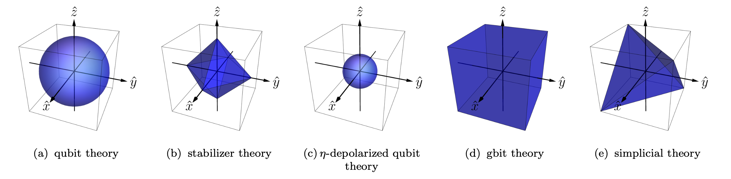
Theories with
Notes:
They all satisfy apart from simplicial. The set of states satisfying the A12 symmetry forms an octahedron inside the tetrahedron, whose vertices are at the midpoints of the edges, i.e. the stabilizer octahedron.
The vertices of the tetrahedron do not satisfy the symmetry, as they don’t manifest operational equivalences.
Notice, however, that our result applies to any theory with some state having A12 symmetry. Not only the theories that have all states satisfying it.
Thanks Giovanni for the very nice figures.

Slide 48
Noncontextuality and uncertainty relations
L. Catani, M. S. Leifer, G. Scala, D. Schmid, R. W. Spekkens, PRL 29 240401 (2022).
Notes:
For all states.
So noncontextuality implies the functional form of the uncertainty relation to be below a linear curve.
SO we have this tradeoff that becomes a noncontextuality inequality.
Not doing the proof. It’s easily followable in the paper. It just consists of choosing a smart parametrization of the ontic space, implement the A12 orbit realizability conditions, noncontextuality and use some simple algebra.
Noise robust. It can be tested experimentally.
In an operational theory, for a state satisfyin A12 orbit realizability with respect to a pair of binary outcome measurements, that we denote X,Z (but don’t need to be orthogonal), then noncontextualtiy implies the tradeoff between X and Z predictabilities to be below a linear curve.
Also the opposite direction holds.
So noncontextuality imposes a nontrivial constraint on the X and Z predictabilities of a state.
X and Z could also be non-complementary.
So the UR it’s a NC inequality. It’s not about a single state as you could pick any in the A12 orbit realizability.
Despite our result shows contextuality of a theory whenever you have one state in your theory satisfying the symmetry and s.t. the bound is violated, our result has deeper significance for theories where all states satisfy the symmetry.
The difference with before is that now the right one is an uncertainty relation, as it applies for any state in the theory. And it is also a noncontextuality inequality.
For theories that have noncontextuality implies a bound on the form of the uncertainty relation.

Slide 49
Main result
Legend
Notes:
So noncontextuality implies the functional form of the uncertainty relation to be below a linear curve.
Notice that the NC bound intersects the quantum ZX UR only for X=1 and Z=0 or vice versa. This is what happens in the toy theory. Max predictability of X and zero of Z or vice versa. Otherwise the qubit can violate the bound and indeed shows contextuality.
Stabilizer UR as noncontextuality inequality.
Qubit maximum violation of the bound is sqrt{2} and gbit is 2. Geometrically easy to see.
Notice that in the case of the simplicial theory, our bound is not a universal constraint on the predictabilities of the theory. Only in the subset of states that satisfy the symmetry, and that indeed satisfy our bound, consistently with the fact that the simplicial theory admit of a noncontextual model.
The vertices, that allow to beat our bound and provide the UR for the simplicial theory, do not satisfy the symmetry and so are not subjected to our result.
Cyrill: maybe for non-orthogonal measurements the bound is even smaller, e.g. , |<M1>| + |<M2>| <=sqrt(1 – sqrt(M1.M2)^2)

Slide 50
What is nonclassical about uncertainty relations?
The functional form of an uncertainty relation can witness contextuality.
Notes:
And so if we come back to the original question “bla bla” the answer is that such an aspect is…/
Not the mere existence of UR!
Under the condition of A1^2 orbit realizability noncontextuality bounds the functional form of the ZX predictability tradeoff below a linear curve.
For theories where this condition applies to all states, the predictability tradeoff is an UR and so it is the functional form of UR that can witness contextuality.
So coming back to what aspects of uncertainty relations witness nonclassicality, the answer is: it is the functional form above the linear curve of quantum UR that captures its nonclassicality. At least in the sense of contextuality.

Slide 51
What is nonclassical about uncertainty relations?
It is not the lack of perfect joint predictability that witnesses nonclassicality, but the greater joint predictability for states satisfying .
Notes:
And there’s a surprising consequence associated with this result.
It is usually thought that the lack of perfect predictability that witness nonclassicality, e.g. in quantum theory. However if one takes nonclassicality as contextuality, it is quite different. It is the greater joint predictability for states satisfying the A12 symmetry that witness nonclassicality.

Slide 52
Contents
Uncertainty relations
What aspects of uncertainty relations witness contextuality
What aspects of quantum interference witness contextuality
Notes:
Now that we have this result on UR and C I want to go back to the question of what aspects of the phenomenology of interference witness nonclassicality. And firstly, I want to focus on what are aspects of quantum interference that have been considered important and providing a more detailed account of such phenomenology. And one is what is known as wave-particle duality relations.
Here we need to focus on aspects that have been considered relevant in the contexts of quantum interference. (Of course it’d be easy to just consider any proof of contextuality on a qubit and map it to the dual-rail qubit. But one would learn very little from this.)

Slide 53
Wave-particle duality relations
Wave-particle duality relations are trade-off relations between
fringe visibility and path distinguishability .
Notes:
In the study of quantum interference WP duality relations is what constitutes an aspect of prior significance.
They quantify…
The fringe visibility in a generic interference pattern is defined as the normalized difference between the maximum and minimum intensities of the pattern.
For the type of interference that is of interest in quantum theory, the pattern is built up from detections of individual particles that exhibit statistical variation in their location (rather than, for instance, describing a continuous physical quantity, such as the height of a water wave). The intensity at a given location tracks the number of detections in that location and is consequently proportional to the probability of finding an individual particle there, so that we can replace intensities with probabilities in the expression for V.
Intensity is power per unit area. So it has a unit of measure unlike probability.
The expression further simplies when we specialize to the case of a Mach-Zehnder interferometer. In the latter, there are only two points in the interference pattern, namely, the two output ports of the second beamsplitter. Consequently, the two probabilities of detection sum to unity, trivializing the denominator.
(Note that in the standard definition of the fringe visibility, the maximum and minimum intensities are obtained by ranging over the phases. In the current experimental setup, the phase shifter is set to a fixed phase shift (this information is contained in the final state of the photon), which provides the phase phi_max that gives maximum intensity on one port, and minimum on the other (or, equivalently, phi_max + pi gives the minimum in the former port). Assuming (or, as we will see later) that the two ports are associated to outcomes +1 and -1 of the Z measurement this means that the visibility we consider detects the coherence relative to Z. I mean, relative to X inside the interferometer.)
Now I want to provide a quantum mechanical expression of V in our MZI. In order to do that I’m gonna move from the second to the first quantized description. In particular, you rememeber that our allowed states where the ones with sum of occupation numbers 1, and so we were considering the subspace of the total Fock space spanned by… . These can be associated with eigenstates of Z (the notation we use above in curly brakets mean the basis). So we associate our MZI to an effective qubit, that I will refer to as the interferometric qubit.
Same for complementary basis with X and beam splitter transformation that now becomes an Hadamard gate.
Moreover notice that the visibility as we defined before as the difference between +1 Z detection and -1 Z detection for the final state, as the ports are now associated with measurement in the Z basis. Z basis is the which-way measurement.
We will consider the state inside the interferometer, so we define the X measurement for V: i.e. the phase coherence or X coherence between the two paths. X is the which-phase measurement.
(The eigenstates of occupation number of mode L are denoted .. . We will consider only scenarios where the total occupation number of the pair of modes is 1, so that we are in the subspace of the total Fock space spanned by the states … . This defines an effective qubit, which we refer to as the interferometric qubit. We associate the product basis … with the eigenstates of the Pauli Z observable of the qubit, so that a which-way measurement can be represented as a measurement of Z. We associate the complementary basis with the eigenstates of the Pauli X observable of the qubit, so that a which-phase measurement can be represented as a measurement of X.)
Finally, if we let theta be a random variable with values in the set {+1;-1} representing the outcome of the which-phase measurement (adopting the convention that +1 is associated to the detection being on the left), and if P denotes the probability distribution over theta , then we have ..
Thus, the fringe visibility is simply the absolute value of the expectation value of the variable that describes the outcome of the which-phase measurement.
Meanwhile, letting W be a random variable with values in the set {+1;-1} representing the outcome of the which-way measurement depicted in Fig. 1(b) (again, adopting the convention that +1 is associated to the excitation being on the left), the path distinguishability D is defined simply as the absolute value of the expectation value of the which-way measurement.

Slide 54
Fringe visibility
Fringe Visibility:
Notes:
The fringe visibility in a generic interference pattern is defined as the normalized difference between the maximum and minimum intensities of the pattern.

Slide 55
Fringe visibility
Fringe Visibility:
Notes:
For the type of interference that is of interest in quantum theory, the pattern is built up from detections of individual particles that exhibit statistical variation in their location (rather than, for instance, describing a continuous physical quantity, such as the height of a water wave). The intensity at a given location tracks the number of detections in that location and is consequently proportional to the probability of finding an individual particle there, so that we can replace intensities with probabilities in the expression for V.
Intensity is power per unit area. So it has a unit of measure unlike probability.

Slide 56
Fringe visibility in Mach-Zehnder interferometer
Fringe Visibility:
Notes:
The expression further simplies when we specialize to the case of a Mach-Zehnder interferometer. In the latter, there are only two points in the interference pattern, namely, the two output ports of the second beamsplitter. Consequently, the two probabilities of detection sum to unity, trivializing the denominator.
(Note that in the standard definition of the fringe visibility, the maximum and minimum intensities are obtained by ranging over the phases. In the current experimental setup, the phase shifter is set to a fixed phase shift (this information is contained in the final state of the photon), which provides the phase phi_max that gives maximum intensity on one port, and minimum on the other (or, equivalently, phi_max + pi gives the minimum in the former port). Assuming (or, as we will see later) that the two ports are associated to outcomes +1 and -1 of the Z measurement this means that the the visibility we consider detects the coherence relative to Z. I mean, relative to X inside the interferometer.)

Slide 57
Path distinguishability in Mach-Zehnder interferometer
Path Distinguishability:
Notes:
Path distinguishabiity is just the difference between the probability of the photon inside the interferometer being on left path and on the right path. Here I denote it with PL and PR. Let me stress that left and right here refers to the photon inside the interferometer.

Slide 58
Fringe Visibility:
Path Distinguishability:
Notes:
The expression further simplies when we specialize to the case of a Mach-Zehnder interferometer. In the latter, there are only two points in the interference pattern, namely, the two output ports of the second beamsplitter. Consequently, the two probabilities of detection sum to unity, trivializing the denominator.
(Note that in the standard definition of the fringe visibility, the maximum and minimum intensities are obtained by ranging over the phases. In the current experimental setup, the phase shifter is set to a fixed phase shift (this information is contained in the final state of the photon), which provides the phase phi_max that gives maximum intensity on one port, and minimum on the other (or, equivalently, phi_max + pi gives the minimum in the former port). Assuming (or, as we will see later) that the two ports are associated to outcomes +1 and -1 of the Z measurement this means that the the visibility we consider detects the coherence relative to Z. I mean, relative to X inside the interferometer.)

Slide 59
Wave-particle duality relations in quantum theory
D. M. Greenberger and A. Yasin, PRA 128, 8 391-394(1988).
Notes:
It turns out that in quantum theory fringe visibility and path distinguishability obey the following relation. There’s a tradeoff between the wave-like and particle-like property.
The tradeoff relation we consider between the fringe visibility V and path distinguishability P holds for all states of the qubit describing the quantum system inside the Mach-Zehnder interferometer. The latter is the qubit associated with the two-dimensional Hilbert space corresponding to the which-path degree of freedom of the system inside the Mach-Zehnder interferometer.
In particular the qubit is defined by being in the left or right state (or superposition of them).
What we have shown, therefore, is that the quantities appearing in the wave-particle duality relation are simply the Z-predictability and X-predictability specialized to the case of an interferometric qubit.

Slide 60
Wave-particle duality relations
Extreme cases
Wave-like behavior
Particle-like behavior
Notes:
The extreme cases in this tradeoff relation are (V,D) = (1,0) and (V,D) = (0,1). These were reproduced by the toy field theory. So the mere existence of wave-particle duality tradeoffs does not constitute an instance of nonclassicality. This is the TRAP phenomenology.
(The first can be achieved by the preparation procedure where the beamsplitter has reflectivity 1/2 (a 50-50 beamsplitter) and the relative phase-shift between the two paths is 0 or pi, because in this case the which-phase measurement is perfectly predictable while the which-way measurement is completely unpredictable. The second point can be achieved by the preparation procedure where the beamsplitter has reflectivity 0 (i.e., no beamsplitter) or reflectivity 1 (a perfect mirror), because in this case it is the which-way measurement that is perfectly predictable and the which-phase measurement that is completely unpredictable.
The wave-particle duality relation describes the tradeoff in predictabilities between these two extreme cases.

Slide 61
Fringe visibility in Mach-Zehnder interferometer
Fringe Visibility:
Notes:
Now I want to provide a quantum mechanical expression of V in our MZI.
We can associated the two paths with the eigenstates of Z. So we associate our MZI to an effective qubit, that I will refer to as the interferometric or dual-rail qubit.
Same for complementary basis with X and beam splitter transformation that now becomes an Hadamard gate.
Moreover notice that the visibility as we defined before as the difference between +1 Z detection and -1 Z detection for the final state, as the ports are now associated with measurement in the Z basis. Z basis is the which-way measurement.
We will consider the state inside the interferometer, so we define the X measurement for V: i.e. the phase coherence or X coherence between the two paths. X is the which-phase measurement.
Finally, if we let theta be a random variable with values in the set {+1;-1} representing the outcome of the which-phase measurement (adopting the convention that +1 is associated to the detection being on the left), and if P denotes the probability distribution over theta , then we have ..
Thus, the fringe visibility is simply the absolute value of the expectation value of the variable that describes the outcome of the which-phase measurement.
For the state INSIDE the interferometer.
It is the which-phase predictability.

Slide 62
Fringe visibility in Mach-Zehnder interferometer
Path Distinguishability:
Notes:
Meanwhile, letting W be a random variable with values in the set {+1;-1} representing the outcome of the which-way measurement depicted in Fig. 1(b) (again, adopting the convention that +1 is associated to the excitation being on the left), the path distinguishability D is defined simply as the absolute value of the expectation value of the which-way measurement. It is the which-way predictability. For the state INSIDE the Mach-Zehnder interferometer.

Slide 63
Wave-particle duality relations
Fringe visibility and path distinguishability
Fringe Visibility:
Path Distinguishability:
Notes:
(In the set-up of a Mach-Zehnder interferometer, the path distinguishability is defined in terms of the statistics of a which-way measurement, while the fringe visibility is defined in terms of the statistics of a which-phase measurement. The tradeoff relation we consider between the fringe visibility V and path distinguishability P holds for all states of the qubit describing the quantum system inside the Mach-Zehnder interferometer. The latter is the qubit associated with the two-dimensional Hilbert space corresponding to the which-path degree of freedom of the system inside the Mach-Zehnder interferometer.
To summarize, the which-way and which-phase measurements on the interferometric qubit are associated to the Pauli Z and Pauli X observables. As noted earlier, the absolute value of the expectation value of a measurement whose outcome is in {+1,-1} is a measure of predictability of the measurement, and so it is apt to refer to |X| and |Z| as the X-predictability and Z-predictability respectively (as is done in Ref. [19]).)

Slide 64
Wave-particle duality relations are uncertainty relations
Notes:
So if you remember our UR from before you have realized that wave-particle duality relations are uncertainty relations!

Slide 65
Wave-particle duality relations as uncertainty relations
Notes:
In particular, are uncertainty relations about the which-phase and which-way measurements.
So we see that wave-particle duality relations are instances of ZX uncertainty relations. Visibility and distinguishability are which-phase and which-way predictabilities about which there is a tradeoff about how much one can jointly predict the which-phase and which-way measurement on the inteferometric qubit. And for every state (inside the Mach Zehnder).

Slide 66
Noncontextuality and wave-particle duality relations
Notes:
With respect to which-phase and which-way measurements.
For all states.
So noncontextuality implies the functional form of the wave-particle duality relation to be below a linear curve.
So we have this tradeoff that becomes a noncontextuality inequality.
Not doing the proof. It’s easily followable in the paper. It just consists of choosing a smart parametrization of the ontic space, implement the A12 orbit realizability conditions, noncontextuality and use some simple algebra.
Noise robust. It can be tested experimentally.
In an operational theory, for a state satisfyin A12 orbit realizability with respect to a pair of binary outcome measurements, that we denote X,Z (but don’t need to be orthogonal), then noncontextualtiy implies the tradeoff between X and Z predictabilities to be below a linear curve.
Also the opposite direction holds.
So noncontextuality imposes a nontrivial constraint on the X and Z predictabilities of a state.
X and Z could also be non-complementary.
So the UR it’s a NC inequality. It’s not about a single state as you could pick any in the A12 orbit realizability.
Despite our result shows contextuality of a theory whenever you have one state in your theory satisfying the symmetry and s.t. the bound is violated, our result has deeper significance for theories where all states satisfy the symmetry.
The difference with before is that now the right one is an uncertainty relation, as it applies for any state in the theory. And it is also a noncontextuality inequality.
For theories that have noncontextuality implies a bound on the form of the uncertainty relation.

Slide 67
What is nonclassical about quantum interference?
The functional form of wave-particle duality relations can witness contextuality.
Notes:
And so if we come back to the original question “bla bla” the answer is that such an aspect is…/
Not the mere existence of WP duality relations!
So we have finally understood what is nonclassical about quantum interference. We can see this result in a simple plot.
Under the condition of A1^2 orbit realizability noncontextuality bounds the functional form of the ZX predictability tradeoff below a linear curve.
For theories where this condition applies to all states, the predictability tradeoff is an UR and so it is the functional form of UR that can witness contextuality.
So coming back to what aspects of uncertainty relations witness nonclassicality, the answer is: it is the functional form above the linear curve of quantum UR that captures its nonclassicality. At least in the sense of contextuality.

Slide 68
Witnessing contextuality via wave-particle duality relations
L. Catani, M. S. Leifer, G. Scala, D. Schmid, R. W. Spekkens, arXiv: 2211.09850 (2022).
Notes:
Where V and P are expectation value of X and of Z. V captures the wave like property and P captures the particle like property.
There are some caveats, e.g. this result works for theories, like QT, that satisfy a particular symmetry condition, and the result leverage the result of this other paper.
The mere existence of wave-particle duality relations -- that are uncertainty relations -- does NOT constitute a proof of nonclassicality. In particular the TRAP phenomenology, reproduced by the noncontextual toy field theory -- was reproducing these two points. It is the particular functional form of them greater than linear that does.
So you go to the lab, you perform your interference experiment (being sure you satisfy also the symmetry condition), if your visibility and distinguishability violate the NC bound, then you know that you’re witnessing true nonclassical interference phenomena.

Slide 69
Some references
This presentation :
Epistemically restricted theories :
What is truly nonclassical about quantum theory :
L. Catani, M. S. Leifer, D. Schmid, R. W. Spekkens, arXiv: 2111.13727 (2021).
L. Catani, M. S. Leifer, G. Scala, D. Schmid, R. W. Spekkens, PRL 29 240401 (2022).
L. Catani, M. S. Leifer, G. Scala, D. Schmid, R. W. Spekkens, arXiv: 2211.09850 (2022).
R. W. Spekkens Phys Rev A 75 (3): 032110 (2007).
R. W. Spekkens, in Quantum Theory: Informational Foundations and Foils, pp 83-135, Springer Dordrecht (2016).
L. Catani, D. E. Browne, New J. Phys. 19, 073035 (2017).
L. Catani, M. S. Leifer, Quantum 7, 948 (2023).
D. Schmid, J. Selby, R. W. Spekkens, arXiv:2009.03297 (2020).

Slide 70
Menti.com
Code:
Notes:
In quantum theory.
Don’t know if you have a preferred notion of nonclassicality? SYNCHRONIZE WITH THE AUDIENCE.
If you don’t know what to answer imagine for example what sounded and still sounds very puzzling about quantum theory when you first study it. I’m sure that given that you’re doing this job you had a moment when you got interested and felt that you have to take up the challenge to solve some unresolved issue in quantum theory.

Slide 71
Witnessing contextuality via wave-particle duality relations
Conclusion of second part
Wave-particle duality relations are uncertainty relations.
For theories satisfying the condition of , the functional form of an uncertainty relation can witness contextuality.
Notes:
The mere existence of wave-particle duality relations does not constitute a proof of nonclassicality. It is the particular functional form of them greater than linear that does.

Slide 72
Conclusion
Conclusion
The TRAP phenomenology of quantum interference does not capture the essence of quantum theory.
The functional form of wave-particle duality relations (that are uncertainty relations) can witness nonclassicality in the form of contextuality.
arXiv:2111.13727, arXiv:2207.11779, arXiv:…
Notes:
So you go to the lab, you perform your interference experiment (being sure you satisfy also the symmetry condition), if your visibility and distinguishability violate the NC bound, then you know that you’re witnessing true nonclassical interference phenomena.

Slide 73
Extra slides

Slide 74
Main result
Notes:
In an operational theory, for a state satisfyin A12 orbit realizability with respect to a pair of binary outcome measurements, that we denote X,Z (but don’t need to be orthogonal), then noncontextualtiy implies the tradeoff between X and Z predictabilities to be below a linear curve.
Also the opposite direction holds.
So noncontextuality imposes a nontrivial constraint on the X and Z predictabilities of a state.
X and Z could also be non-complementary.
SO we have this tradeoff that becomes a noncontextuality inequality.
Not doing the proof. It’s easily followable in the paper. It just consists of choosing a smart parametrization of the ontic space, implement the A12 orbit realizability conditions, noncontextuality and use some simple algebra.
Noise robust. It can be tested experimentally.
So the UR it’s a NC inequality. It’s not about a single state as you could pick any in the A12 orbit realizability.
Despite our result shows contextuality of a theory whenever you have one state in your theory satisfying the symmetry and s.t. the bound is violated, our result has deeper significance for theories where all states satisfy the symmetry.

Slide 75
Main result
The noncontextual bound
Notes:
If we draw without modules, we really see that the noncontextual bound corresponds to the edges of the stabilizer square in the ZX plane, and which is contained in the Bloch circle. It is also the state space of the closure of Spekkens toy theory.

Slide 76
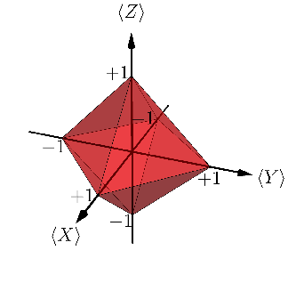
Main result
The case of three measurements
Notes:
Noise robust. It can be tested experimentally.
So the UR it’s a NC inequality. It’s not about a single state as you could pick any in the A12 orbit realizability.

Slide 77
Motivation
The basic phenomenology of features usually considered as truly nonclassical is exhibited in theories admitting of a noncontextual ontological model.

Slide 78
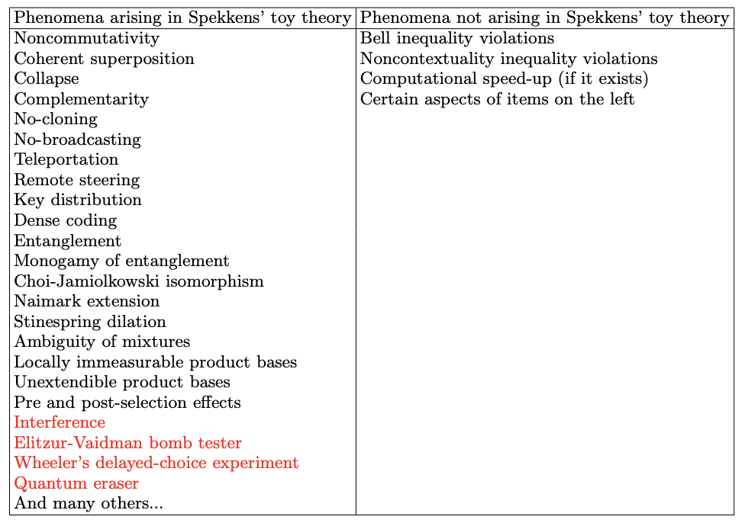
Motivation
Motivation
R. W. Spekkens, in Quantum Theory: Informational Foundations and Foils, pp 83-135, Springer Dordrecht (2016).
*L. Catani, M. Leifer, D. Schmid and R.W. Spekkens, arXiv:2111.13727 (2021).
Notes:
The red ones are novel with respect to the table in Spekkens’ paper.

Slide 79
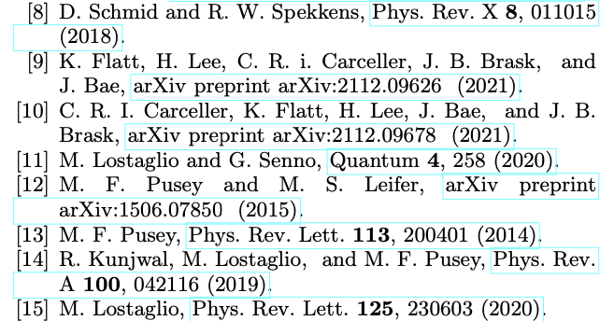
Motivation
The basic phenomenology of features usually considered as truly nonclassical is exhibited in theories admitting of a noncontextual ontological model.
Which aspects of those phenomena witness contextuality?

Slide 80
The TRAP phenomenology in the toy field theory
L. Catani, M. S. Leifer, D. Schmid, R. W. Spekkens, arXiv: 2111.13727 (2021).
Notes:
This figure is not made to be understood, just to show that there is a such a theory. It is taken from this paper, that I presented last year at QPL, so if this made you curious you can go and have a look at it.
Need to say what is the toy field theory and how it reproduces the TRAP phenomenology.
Wave-like behaviour on top and particle-like on the bottom.
The toy field theory is a classical statistical theory over discrete fields (two field modes associated witht he left and right paths) with an epistemic restriction, i.e. a restriction on what probability distributions are allowed.
(I’ll say this later: Crucially for reproducing this is to use an ontology of fields and the fact that the analogue of the quantum state, in particular the vacuum state, is a state of knowledge. In particular the vacuum state is a valid state of knowledge as any other, and so it can carry information, in particualar the information of the local phase.)
(The first can be achieved by the preparation procedure where the beamsplitter has reflectivity 1/2 (a 50-50 beamsplitter) and the relative phase-shift between the two paths is 0 or pi, because in this case the which-phase measurement is perfectly predictable while the which-way measurement is completely unpredictable. The second point can be achieved by the preparation procedure where the beamsplitter has reflectivity 0 (i.e., no beamsplitter) or reflectivity 1 (a perfect mirror), because in this case it is the which-way measurement that is perfectly predictable and the which-phase measurement that is completely unpredictable.
The wave-particle duality relation describes the tradeoff in predictabilities between these two extreme cases.

Slide 81
The TRAP phenomenology in the toy field theory
L. Catani, M. S. Leifer, D. Schmid, R. W. Spekkens, arXiv: 2111.13727 (2021).
Notes:
This figure is not made to be understood, just to show that there is a such a theory. It is taken from this paper, that I presented last year at QPL, so if this made you curious you can go and have a look at it.
Need to say what is the toy field theory and how it reproduces the TRAP phenomenology.
Wave-like behaviour on top and particle-like on the bottom.
The toy field theory is a classical statistical theory over discrete fields (two field modes associated witht he left and right paths) with an epistemic restriction, i.e. a restriction on what probability distributions are allowed.
(I’ll say this later: Crucially for reproducing this is to use an ontology of fields and the fact that the analogue of the quantum state, in particular the vacuum state, is a state of knowledge. In particular the vacuum state is a valid state of knowledge as any other, and so it can carry information, in particualar the information of the local phase.)
(The first can be achieved by the preparation procedure where the beamsplitter has reflectivity 1/2 (a 50-50 beamsplitter) and the relative phase-shift between the two paths is 0 or pi, because in this case the which-phase measurement is perfectly predictable while the which-way measurement is completely unpredictable. The second point can be achieved by the preparation procedure where the beamsplitter has reflectivity 0 (i.e., no beamsplitter) or reflectivity 1 (a perfect mirror), because in this case it is the which-way measurement that is perfectly predictable and the which-phase measurement that is completely unpredictable.
The wave-particle duality relation describes the tradeoff in predictabilities between these two extreme cases.

Slide 82
Criteria for a good notion of classicality
Instance of Leibnizian methodological principle / no fine-tuning.
Applicable to a broad range of physical scenarios.
Subject to direct experimental test.
Constitutes a resource.
L. Catani, M. S. Leifer, Quantum 7, 948 (2023).
D. Schmid, J. Selby, R. W. Spekkens, arXiv:2009.03297 (2020).
Notes:
Basically it’s a no-conspiracy principle for what constitutes a good realist explanation of a physical theory.

Slide 83
Operational theories
Operational theories
Operational theory in a prepare and measure scenario:
Preparation
Measurement and outcome
Predicted statistics
Notes:
An operational theory in a prepare and measure stipulates the preparations the measurements and an algorithm for computing the predicted probabilities of an outcome given preparation and measurement for all possible preparations and measurements.
We can imagine that each preparation and measurement effect as a real-valued vectors, and the probability is given by their inner product.

Slide 84
Ontological models and Noncontextuality
Ontological model of an operational theory
Each system ontic state space describing possible ontic states .
Preparation
Measurement and outcome
Predicted statistics
Notes:
The theory predicts well because there’s actual system that is subjected to the experimental procedures. It has physical properties defined as ontic states.
Since we consider Lambda finite, we can represent the probability distributions as vectors.

Slide 85
Ontological models and Noncontextuality
Preparation noncontextuality
Two preparations are operationally equivalent, , if
In a preparation noncontextual ontological model,
In particular,
R.W. Spekkens, Phys. Rev. A 71, 052108 (2005)
Notes:
Where the w_i are probability distributions.
I presented the notion for preparations but it extends also to transformations and measurements and it is known as generalized contextuality.
Of the examples before, qubit QT, gbit theory and eta-depolarizing qubit theory when eta less than 2/3 do not admit of NC ontological model. Simplicial and stabilizer yes.

Slide 86
How to link uncertainty relations and contextuality?
Solution:
Consider tradeoff relations for a state that satisfies the condition of
.
Notes:
Consider operational theories with a pair of joint measurements, denoted X,Z, and a state that satisfies the condition of A12 orbit realizability.
This is the condition that allows to connect uncertainty relations and contextuality.

Slide 87
The condition
The state has equal predictability counterparts.
The state manifests operational equivalences with such counterparts.
Example in the qubit theory:
Notes:
i.e. there exists other states (at least other 3) that have the same predictabilities, the modulus of expectation values, for X and Z. Other states manifest those predictabilities, so they also show the same uncertainty relation!
i.e. among these states there are at least 3 with which the state can have operational equivalence. Moreover, among these states there are operational equivalences.
So they lie in a rectangle in a plane parallel to the ZX plane. These vertices are the orbit of the original state under the action of the symmetry group of a rectangle under reflections, the Coxeter group A21. That’s why the name. Basically it’s a rectangle condition.

Slide 88
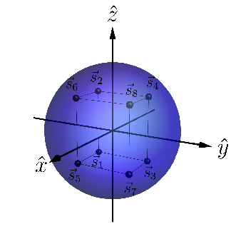
Main result
Generalization to three measurements
In any operational theory, if one can find a triple of measurements, and a state that satisfies the condition of , then noncontextuality implies that
Example of
in qubit theory:
25/27
Notes:
Noise robust. It can be tested experimentally.
So the UR it’s a NC inequality. It’s not about a single state as you could pick any in the A12 orbit realizability.

Slide 89
Main result
Generalization to three measurements
26/27
Notes:
Noise robust. It can be tested experimentally.
So the UR it’s a NC inequality. It’s not about a single state as you could pick any in the A12 orbit realizability.

Slide 90
R. W. Spekkens Phys Rev A 75 (3): 032110 (2007).
Some references
This work :
Epistemically restricted theories :
What’s truly nonclassical about quantum theory :
L. Catani, M. S. Leifer, G. Scala, D. Schmid, R. W. Spekkens, arXiv: 2207.11779 (2022).
S. Bartlett, T. Rudolph, R. W. Spekkens, Phys Rev A 86, 012103 (2012).
R. W. Spekkens, in Quantum Theory: Informational Foundations and Foils, pp 83-135, Springer Dordrecht (2016).
L. Catani, D. E. Browne, New J. Phys. 19, 073035 (2017).
L. Catani, M. S. Leifer, D. Schmid, R. W. Spekkens, arXiv: 2111.13727 (2021).
L. Catani, M. S. Leifer, arXiv:2003.10050 (2020).
D. Schmid, J. Selby, R. W. Spekkens, arXiv:2009.03297 (2020).

Slide 91
What is non-classical about quantum interference?
In a follow-up work we show that the precise trade-off between visibility of fringes and which-way distinguishability in any preparation noncontextual model is linear, , while in quantum theory it is quadratic (Englert inequality), .
Notes:
We want to understand quantum theory. In order to do so we think we need to single out the features that are inherently nonclassical of quantum theory. In this work we show that interference phenomena are not among those features, unlike usually claimed, by providing a classical statistical theory – the toy field theory -- that reproduces those phenomena within a classical worldview (explicitly refuting all the radical interpretational claims that are usually taken to be implied by quantum interference phenomena). With this work we also want to promote a more rigorous way of studying nonclassicality.

Slide 92
What is non-classical about quantum interference?
It is possible to provide a classical account of the TRAP phenomenology of quantum interference. However, reproducing the precise trade-off between visibility and distinguishability in quantum theory requires contextuality.
Notes:
We want to understand quantum theory. In order to do so we think we need to single out the features that are inherently nonclassical of quantum theory. In this work we show that interference phenomena are not among those features, unlike usually claimed, by providing a classical statistical theory – the toy field theory -- that reproduces those phenomena within a classical worldview (explicitly refuting all the radical interpretational claims that are usually taken to be implied by quantum interference phenomena). With this work we also want to promote a more rigorous way of studying nonclassicality.

